Slide 1
Fine-tuning Llama2-7B-Chat for Privacy Policy Q&A and Summarization
(Fine-tuning Llama2)
Chris Puzzo, Christian Jackson
4/29/2024
UNH COMP 741/841 Sabin

Slide 2
Overview of AI System
(Christian)
Problem: Can a smaller, locally hosted, LLM be fine-tuned to exhibit expertise in a particular domain e.g. structure of privacy policies?
benefits
Solution: 7 billion parameter LLM that can be used to summarize and answer questions about privacy policies.
Natural language processing (NLP)
Summarization
Question/answer
Large Language Model
Meta Llama 2-7b-chat (Meta AI 2023)
Dataset: sjsq PrivacyPolicy

Slide 3
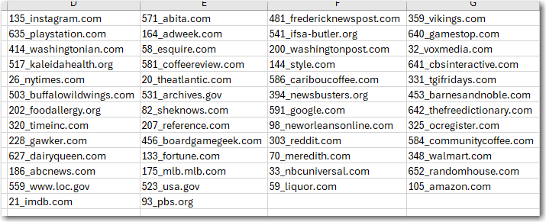
Training Dataset
(Christian)
Source: https://huggingface.co/datasets/sjsq/PrivacyPolicy
CSV contains 1789 records
50 unique privacy policies

Slide 4
Overview of Theoretical Background
(ChrisP)
Theoretical background
LLMs
Transformers
NLP Tasks
Fine Tuning
Peft/QLoRA (Mangrulkar et. al 2022)

Slide 5
AI System: structure, functionality, and performance (Chris, Christian)
Built using several Huggingface resources
Transformers
Llama 2 (7b-chat model)
PEFT/QLoRA
Functionality
Ask questions about privacy policies
Get a summary of a privacy policy
Performance: TBA
Testing methodologies ROUGE vs. BLEU

Slide 6
BLEU Score
BLEU = Bilingual Evaluation Understudy
Calculates a score based on a comparison of word matches between two pieces of text
Typically used for evaluating machine translations
A brevity penalty is applied when the translated text is shorter than the reference text
BLEU scores range from 0 to 1
higher value = better translation quality
perfect translation score == 1
completely incorrect translation score == 0

Slide 7
ROUGE Score
ROUGE = Recall-Oriented Understudy for Gisting Evaluation
Used for evaluating text summarization tasks
Compares machine generated summaries to summaries provided by humans
Measures the similarity between the two summaries by comparing word sequences that appear in both

Slide 8
Demo: Fine-tuning
(Chris)

Slide 9
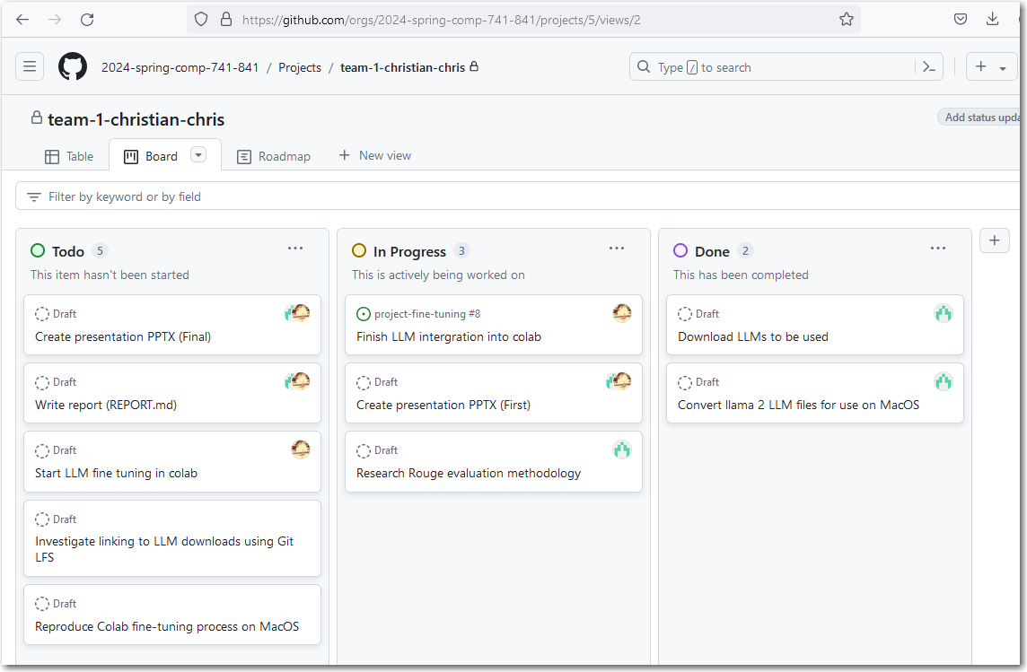
Project Management
(Christian)

Slide 10
References
Meta AI. 2023. “Llama 2: Open Foundation and Fine-Tuned Chat Models”. Accessed April 29 2024. https://scontent-bos5-1.xx.fbcdn.net/v/t39.2365-6/10000000_662098952474184_2584067087619170692_n.pdf?_nc_cat=105&ccb=1-7&_nc_sid=3c67a6&_nc_ohc=slMdknTWhmgAb4No-kc&_nc_ht=scontent-bos5-1.xx&oh=00_AfDsuxJIzD0TuuI-UnHAnMN99UoPSUpXJ3oe8jCo9NRdgg&oe=6635EA3F
Sourab Mangrulkar and Sylvain Gugger and Lysandre Debut and Younes Belkada and Sayak Paul and Benjamin Bossan. 2022. “PEFT: State-of-the-art Parameter-Efficient Fine-Tuning methods”. Accessed April 29 2024. https://github.com/huggingface/peft
Sjqj. 2024. “PrivacyPolicy”. Accessed April 29 2024. https://huggingface.co/datasets/sjsq/PrivacyPolicy
Belkada, Younes, Jul 21, 2023, finetune_llama_v2.py. Accessed April 29, 2024. https://gist.github.com/younesbelkada/9f7f75c94bdc1981c8ca5cc937d4a4da
Chiusano, Fabio. 2023. “Two Minutes NLP — Learn the ROUGE Metric by Examples.” NLPlanet (blog). August 4, 2023. Accessed April 30, 2024. https://medium.com/nlplanet/two-minutes-nlp-learn-the-rouge-metric-by-examples-f179cc285499.

